Slide 1
Unit 4
Jordan

Slide 2
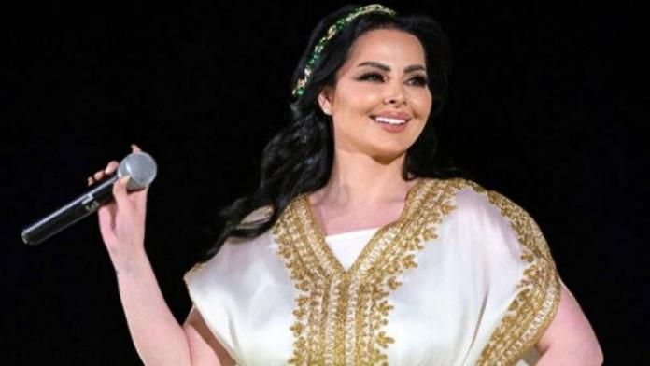
Diana is a beautiful, young pop star from Amman, the capital of Jordan.
She has long, brown hair, big, brown eyes, and long, dark eyelashes.

Slide 3
She speaks Arabic, and she sings in Arabic, too.
One of her most famous songs is Ensani ma bensak
(I won’t Forget You).

Slide 4
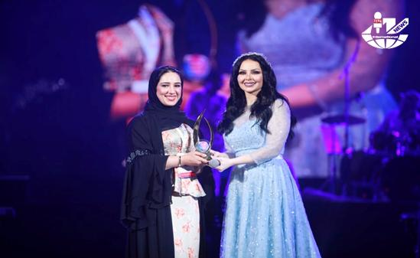
She is famous and she has won a lot of singing competitions.
She has traveled around the world singing her songs, and she has sold many records.

Slide 5
Unit 5
Madagascar

Slide 6
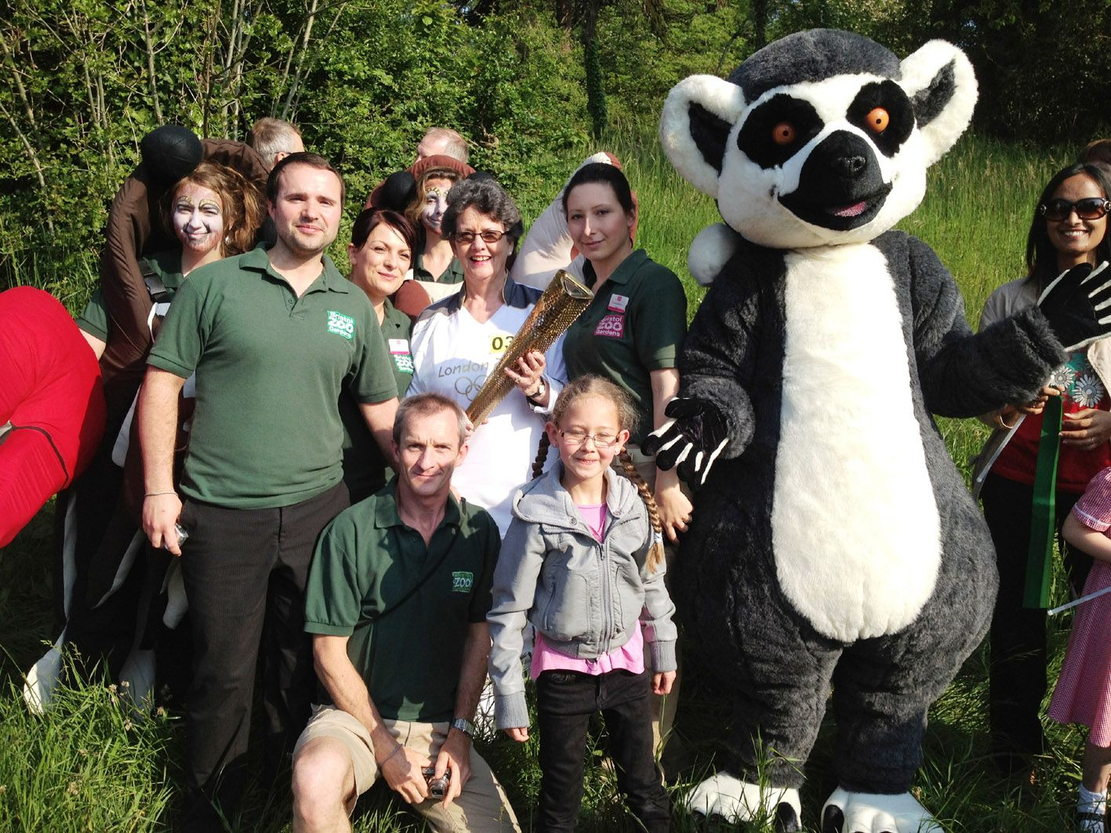
WELCOME TO MADAGASCAR!
First, meet Larry the Lemur.
He’s the mascot of Madagascar.

Slide 7
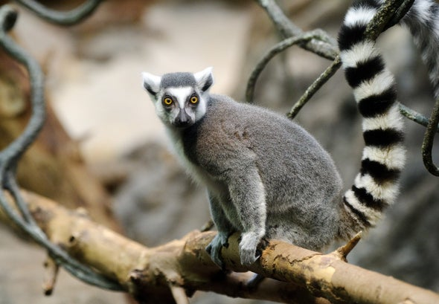
Lemurs are small mammals.
They are many different lemurs, but Larry is a ring-tailed lemur.

Slide 8
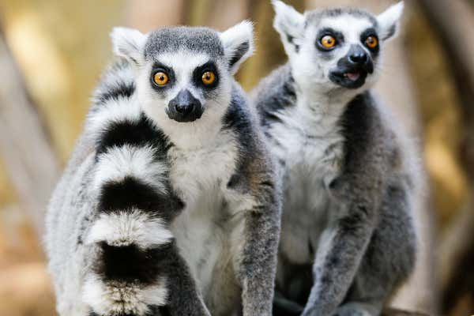
Ring-tailed lemurs have big eyes and a face like a teddy bear. They have a long, striped tail. They’re really cute (and noisy).

Slide 9
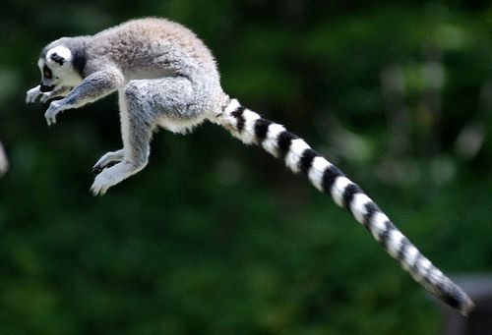
Lemurs live in rain forests of Madagascar where they jump from tree to tree.
They live in the trees, and they eat fruit, leaves, and insects.

